Slide 1
Camunda 8 Self-Managed Deployment
Self Managed Deployment Use Cases
Notes:
Process Orchestration

Slide 2

The
Universal
Process
Orchestrator
Orchestrate. Automate. Transform.

Slide 3


Content
About CAMUNDA
Solution Diagram
CaseStudy
Demonstration
Camunda Open Source Vs Enterprise Editions
Q&A
Notes:
#1 Agenda Slide
#2a Slide - What is Caterpillar Business challenge (Krishna to fill it up) We need a solution where IT and business to collaborate, which is scalable and resilient
#2b Slide - Why Camunda Solution Camunda help orchestrate multiple endpoints Developer friendly Open Architecture End-to-end orchestration standards-based collaboration Business and IT can collaborate Solution can be scalable and resilient
#3 Slide - Camunda orchestrate, Automation, Transform
#4 - Comparision between Camunda SaaS and Self-Managed (need to discuss with Krishna on removing the optimizer from the free version list) - completed

Slide 4


^{What we need?}
^{Customer} ^{Challenges!}
Process Orchestration which can help connect multiple applications
Business Rules to configure the templates and attributes required for the Report.
Make business Processes agile & configrable to suit business demands
^{Why CAMUNDA?}
Gather Data from Multiple applications
^{Complex} custom logic to process the data
Business and IT teams struggle to communicate and collaborate to publish new Reports.
^{End-to-End Orchestration}
^{Standards-based}
^{Collaboration}
^{Developer-Friendly}
^{Open Architecture}
^{Cost-Effective}

Slide 5
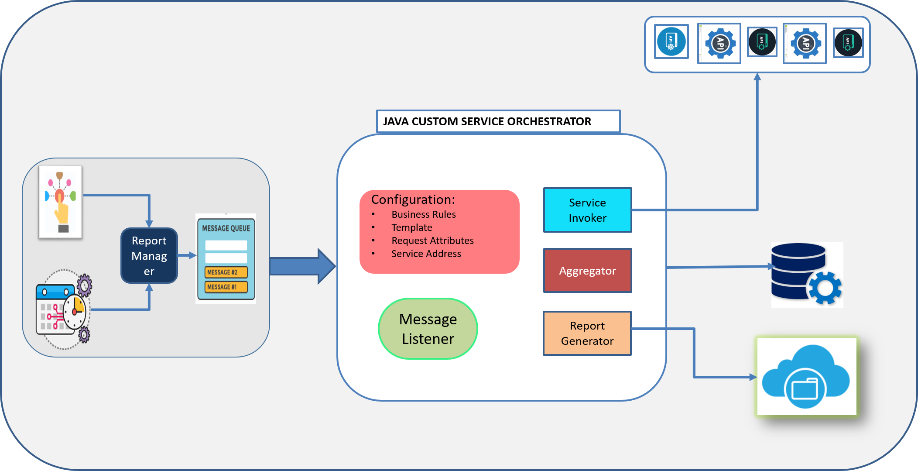
EXISTING SOLUTION
Background
Report Templates and Attribute Configured in Static way.
Complex Custom Java Solution to aggregate, transform data and generating Reports
Development time to built new Reports is considerable high

Slide 6
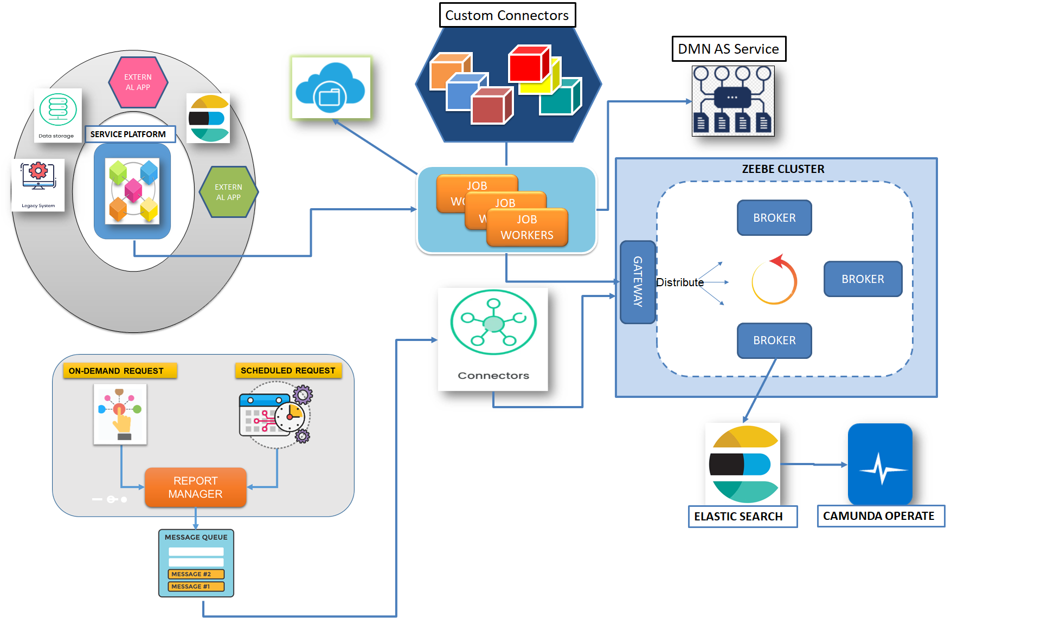
SOLUTION IMPLEMENTED
Benefits
Process Orchestration made easy to gather data from multiple applications
Re-Usable Components via Custom Connectors reduced 60% development time
Rule Engine (DMN) As a Service help the business to configure the Report and Report Attributes
Service Orchestration has helped to generate the huge volumes of Report Data in quick turn around time (< 1 min)

Slide 7
Prepare Elastic Search Index
Get Equipment Reference Worker
Download Equipment Usage Data Set
Merge Data Set
Prepare File in Cloud Data Storage
Fetch Report Template Configurations
Write to File in Cloud Data Storage
CAMUNDA
SOLUTION
DEMO
Equipment
Management
Report
7

Slide 8

Overall Benefits – Design, Development & Effort
40% of logic has been moved as reusable components (Connectors) which can be used across the reports & developers has the flexibility to drag & drop the connectors while designing the process
Data Set download
Data Merging Component
Report generation based on template
Data upload to storage
10% of the static business key attributes are moved into configurable business rules (DMN) & Business users has the flexibility to update the business rules
Template configurations
Service end points
Request attributes to download the data via endpoints
Attributes for report sections
60% of Total effort has been reduced in development effort
8

Slide 9



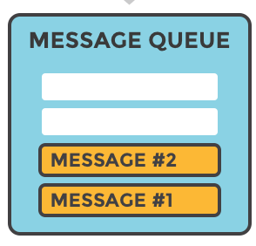


JAVA CUSTOM SERVICE ORCHESTRATOR
Ja
Configuration:
Business Rules
Template
Request Attributes
Service Address
Service Invoker
Report Manager
Aggregator
Message Listener
Report Generator

